Slide 1
MLMQ Mat Luke Message Queuing
Advanced Systems Lab – Milestone 1
Matthias Ganz & Lukas Elmer
HS 13/14
ETHZ

Slide 2
Agenda
Design
Overview
Middleware
Database
Interface
Experiments
Setup
Summary
Results
2h Trace
Lessons Learned about the System

Slide 3
Design

Slide 4
Design – Overview
Client
Client
Client
Middleware
Database
Client
Client
Client
TCP IP Sockets
Middleware
JDBC
Client
Client
Client
Middleware

Slide 5
Design – Middleware
Middleware
NIO
Request Queue
Worker Pool
DB Connection Pool
Client
Database
Client
Response Queue
Client
Buffer Pool
Notes:
NIO: Expensive:
Create network connections
Pools: Expensive:
Create threads
Establish DB connections
Create objects
Queues: concurrent, workers work independently

Slide 6
Design – Middleware
Middleware
Request Queue
NIO
DB Connection Pool
Client
Database
Client
Client
Client
Client
Worker
Response Queue
Buffer Pool
Notes:
NIO: Expensive:
Create network connections
Pools: Expensive:
Create threads
Establish DB connections
Create objects
Queues: concurrent, workers work independently

Slide 7
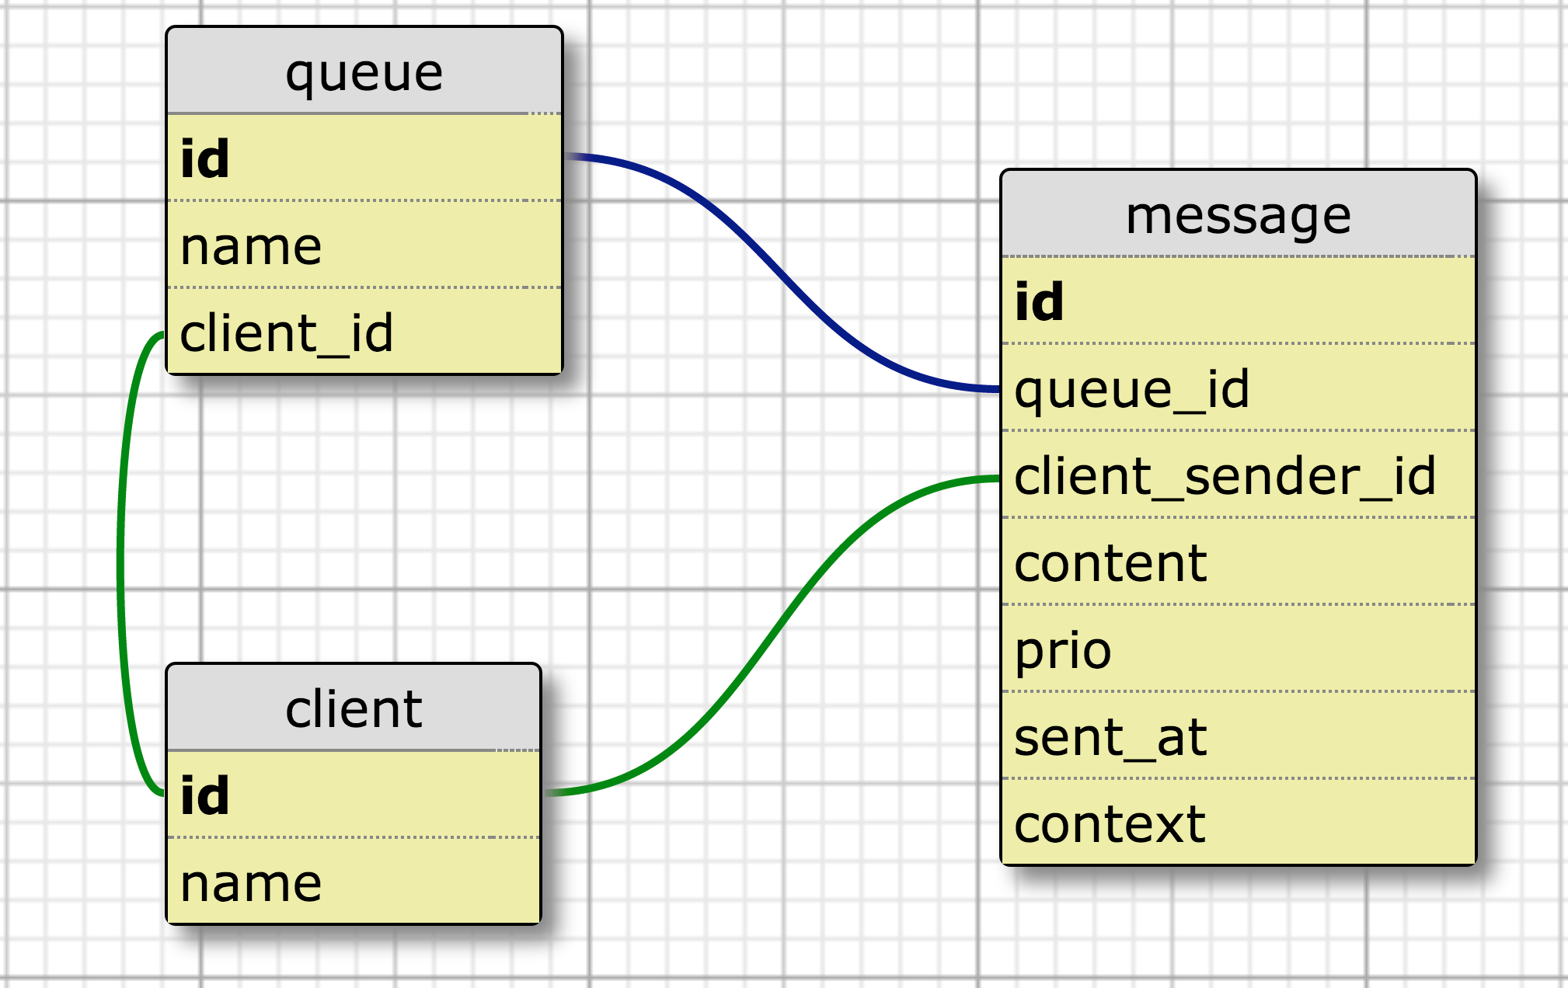
Design – Database
Notes:
KISS
Context: For request – response
Otherwise would use two fields is_request_response and message_id
No receiver_id: Every client owns a private queue

Slide 8
Design – Database
Indices (B-Trees)
Queue: client_id
Client: name
Message: queue_id, prio, sent_at, client_sender_id, context
Stored procedures
peekMessage
peekMessageForUpdate
Locks a specific record for dequeuing

Slide 9
Design – Interface
ClientDto register()
ClientDto lookupClient(String clientName)
QueueDto lookupClientQueue(long clientId)
QueueDto createQueue(String queueName)
QueueDto lookupClientQueue(String queueName)
void deleteQueue(long id)
void sendMessage(long queueId, byte[] content, int prio)
void sendMessage(long[] queueIds, byte[] content, int prio)
void sendMessageToClient(long clientId, byte[] content, int prio)
long sendRequestToClient(long client, byte[] content, int prio)
long sendResponseToClient(long clientId, long context, byte[] content, int prio)
int queuesWithPendingMessages(List<QueueDto> queues, int maxNumQueues)
MessageDto peekMessage(MessageQueryInfoDto messageQueryInfo)
MessageDto dequeueMessage(MessageQueryInfoDto messageQueryInfo)

Slide 10

Experiments

Slide 11
Experiments – Setup
Client
Client
Client
Middleware
Database
Client
Client
Client
Middleware
Client
Client
Client
Middleware
?
Config

Slide 12
Experiments – Setup
Client
Client
Client
Middleware
Database
Client
Client
Client
Middleware
Client
Client
Client
Middleware
Config
Testmaster

Slide 13
Experiments – Setup
Client
Client
Client
Middleware
Database
Client
Client
Client
Middleware
Client
Client
Client
Middleware
Testmaster
Logs

Slide 14
Experiments – Setup
Client
Client
Client
Middleware
Database
Client
Client
Client
Middleware
Client
Client
Client
Middleware
Testmaster
Logs
Plots & Statistics

Slide 15
Experiments – Sequential Test
Client
Client
Client
Middleware
Database
Client
Client
Client
Middleware
Client
Client
Client
Middleware
Testmaster

Slide 16
Experiments – Parallel Tests
Client
Client
Client
Client
Client
Client
Client
Middleware
Client
Middleware
Client
Middleware
Database
Database
Database
Client
Client
Client
Client
Client
Client
Client
Middleware
Client
Middleware
Client
Middleware
Client
Client
Client
Client
Client
Client
Client
Middleware
Client
Middleware
Client
Middleware
Testmaster 1
Testmaster 2
Testmaster N
BTW: You cannot start more than 20 EC2 instances in parallel
=> Request to Increase Amazon EC2 Instance Limit

Slide 17
Experiments – Summary
Stability
2h Trace
Best configuration
Throughput vs. response time
2^{k} Test
System limit
Load tests
Bottlenecks, optimization Points
Which component spends how much time

Slide 18
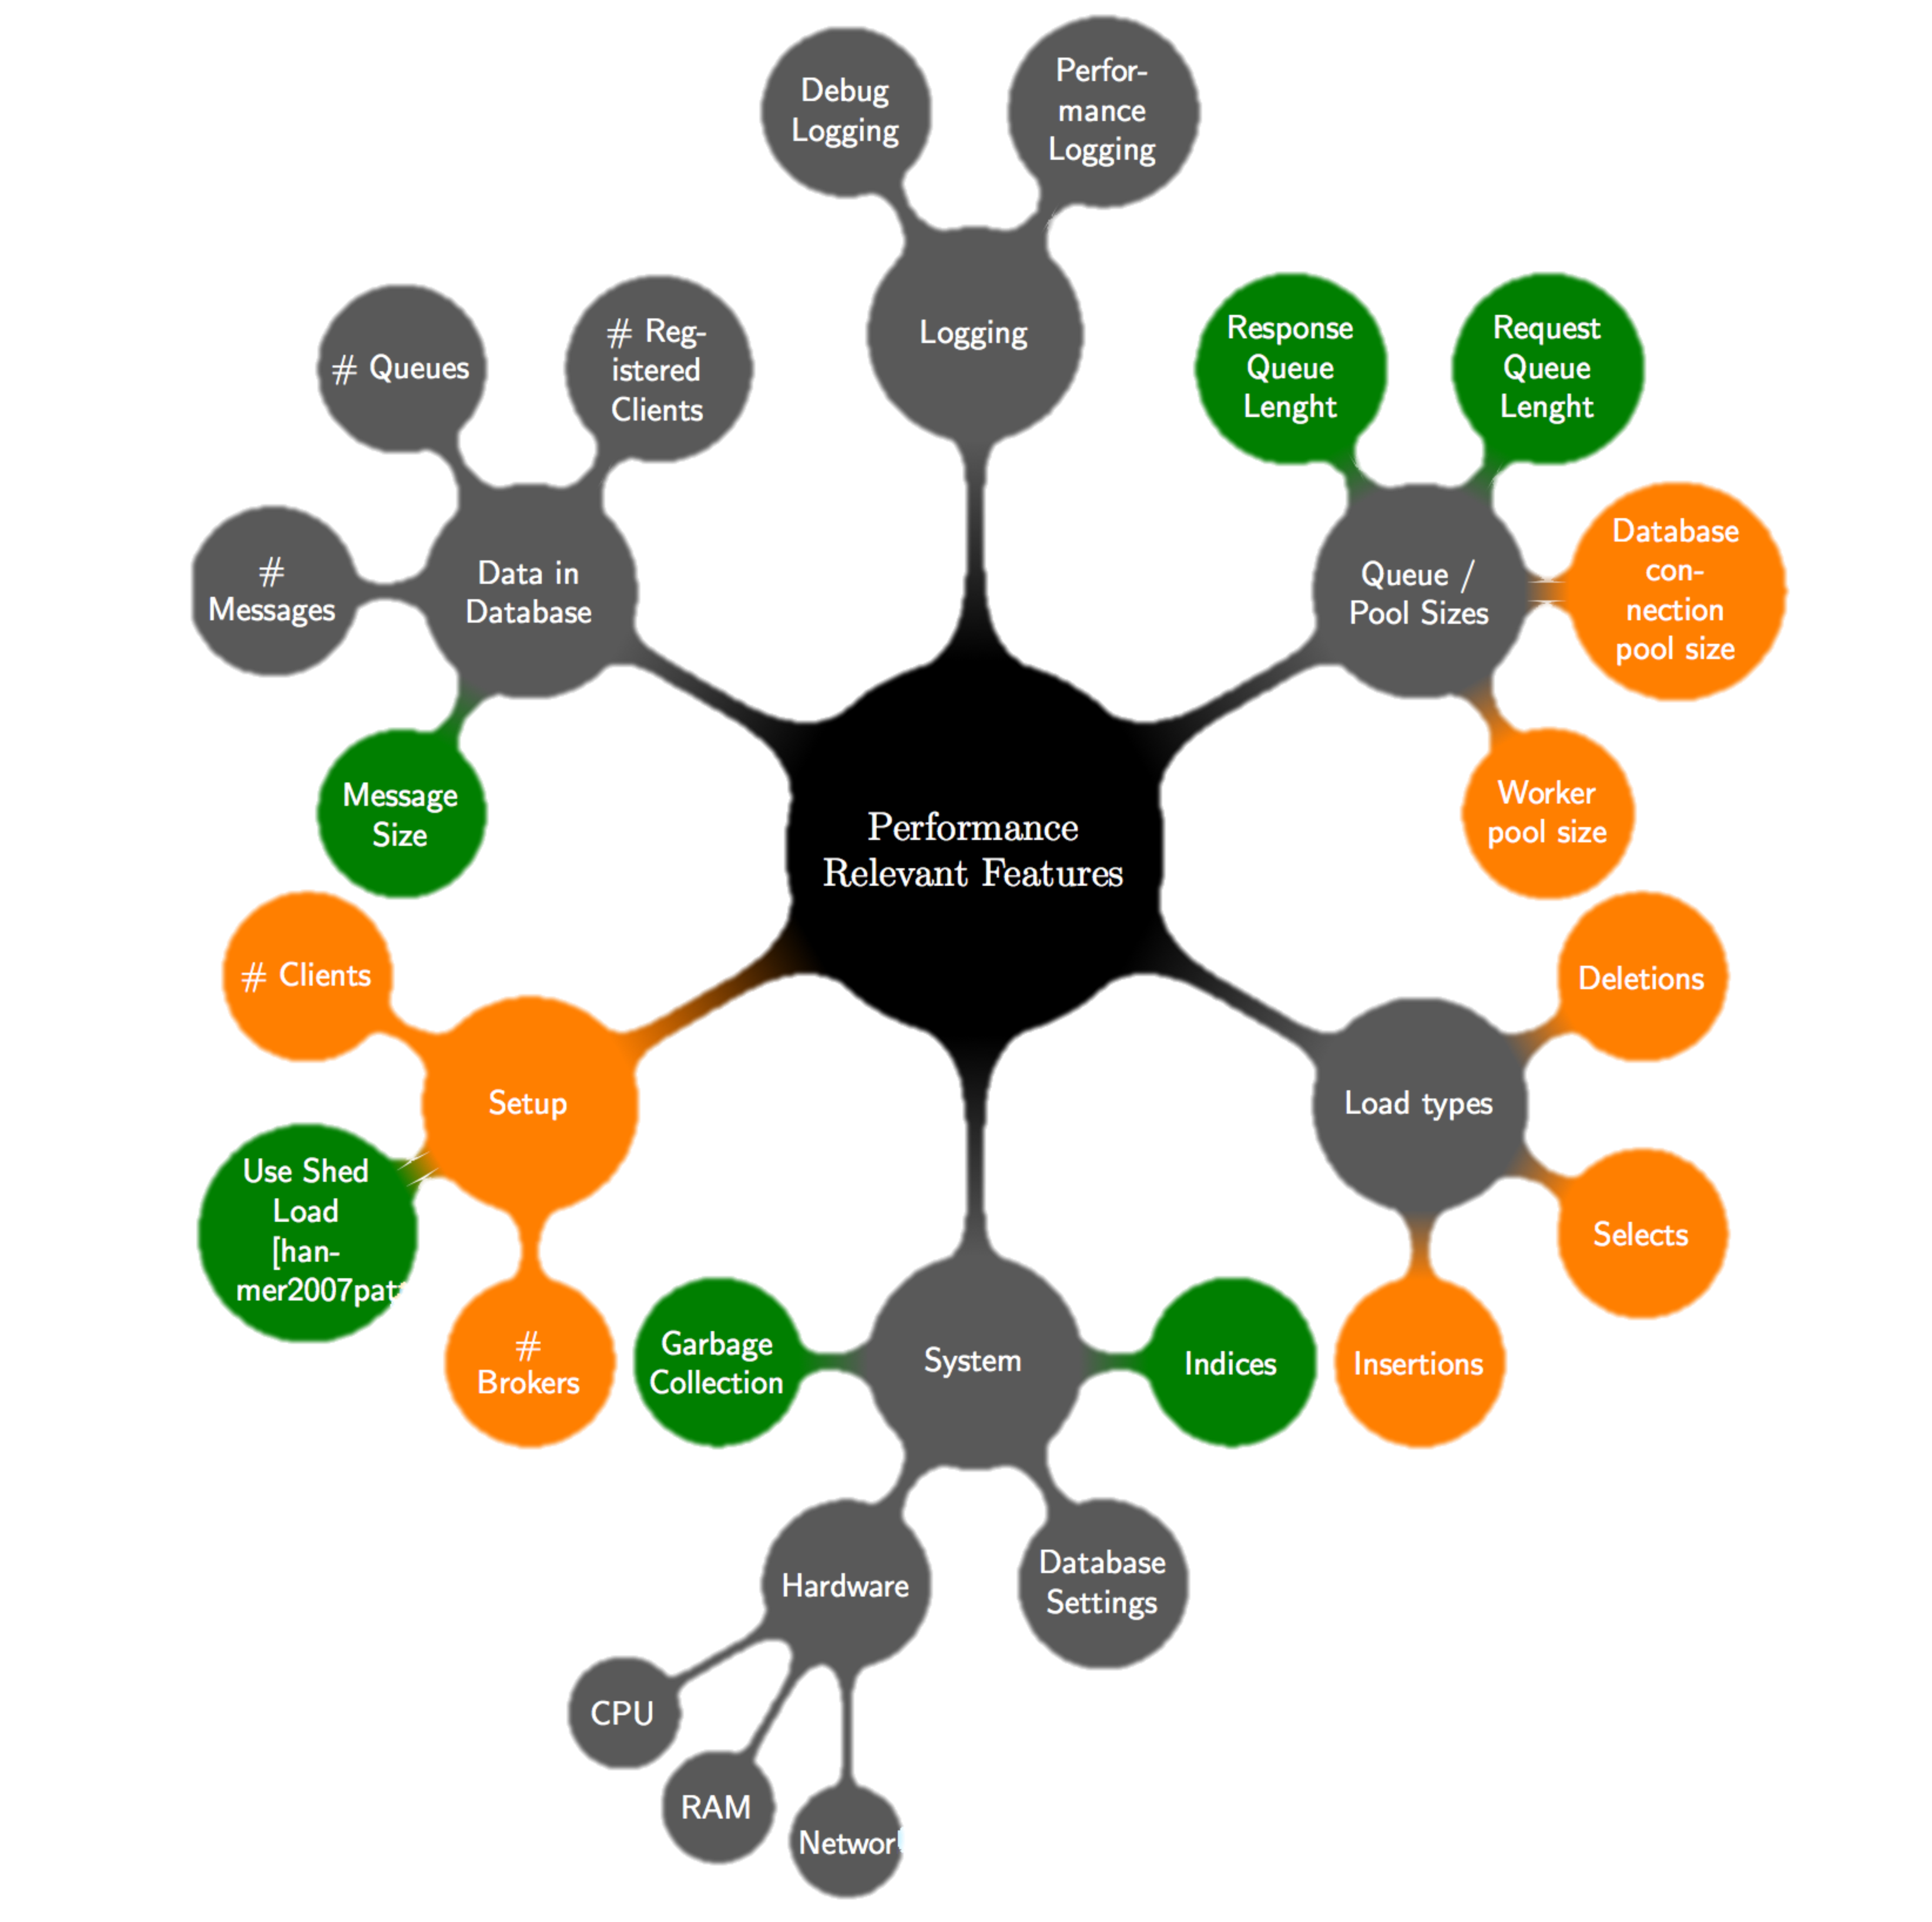
Experiments – Summary: Features

Slide 19
Experiments – Summary: Primary Features
# Clients
# Brokers
DB Connection Pool Size
Worker Pool Size
2^{k} Test

Slide 20
Experiments – Results: 2^{k} Test
Throughput
TODO: insert throughput

Slide 21
Experiments – Results: 2^{k} Test
Response time
TODO: insert response time

Slide 22
Experiments – Results

Slide 23
Experiments – Results

Slide 24
Experiments – Results

Slide 25
Experiments – 2h Trace
TODO: insert plot

Slide 26
Experiments – 2h Trace
For the 2h Test configuration
For 95% of all sendMessage requests, the response time will be under TODO ms
For 95% of all peekMessage requests, the response time will be under TODO ms
For 95% of all dequeueMessage requests, the response time will be under TODO ms

Slide 27
Lessons Learned about the System
Improvements during this milestone
Response time stability
Throughput
Saturated system
=> higher throughput
=> higher variance in response time
Improvement potential / bottleneck: Database

Slide 28
Questions
Thank you

